Slide 1







WORKSHOP
ON
Facilitated by Abdirahman Sheikhdon, Abdirisak Mohamed Adan & Abdirisak Hashi
INNOVATIVE TEACHING AND LEARNING IN HIGHER EDUCATION
Organized by SomaliREN,
Hotel Jawhara, Mogadishu, Somalia
29th to 30th June 2024
in Higher Education
4th May 2023

Slide 2


Introduction and Objective
HEIs are expected to educate larger numbers of students, creating new opportunities for graduates, research, and innovation. It is, therefore, necessary to skill up the capacity of teaching staff to realize the goal of higher education.
The main objective is to utilize innovative teaching-learning approaches to address the needs of learners in practical ways.

Slide 3

Introduction
Name,
Qualification,
Position, and
Institution

Slide 4

Norms

Slide 5

Expectation
Enhancing communication between the facilitator and the participants

Slide 6
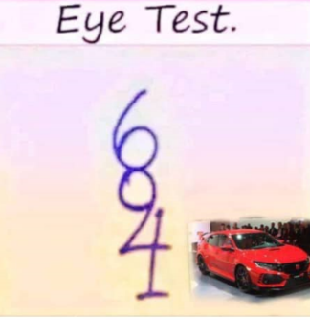

Slide 7

Your age?

Slide 8





Slide 9
What challenges do you face as teaching staff in higher education?

Slide 10













Learning theory
LEARNING THEORY
A theory is a set of organized principles that explain something.
Learning theories are ideas about ways students learn, process, and retain information.
Theories of learning enable the evidence-informed design of curriculum, learning activities, and assessment.

Slide 11
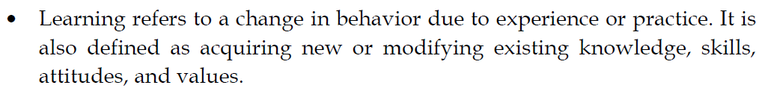
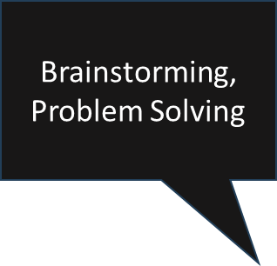




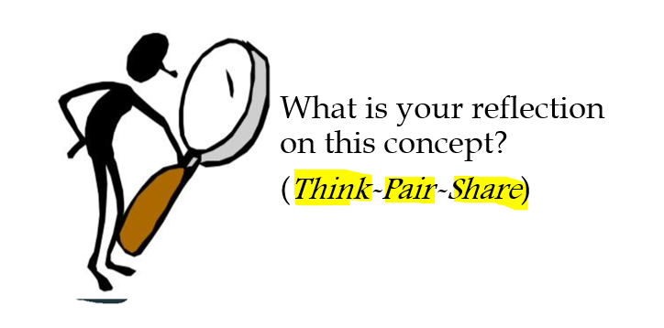











Learning theories are ideas about the ways students LEARN PROCESS and RETAIN information
Learning is to:
Think
Read
Write
Do
Share

Slide 12
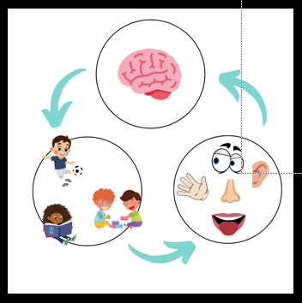
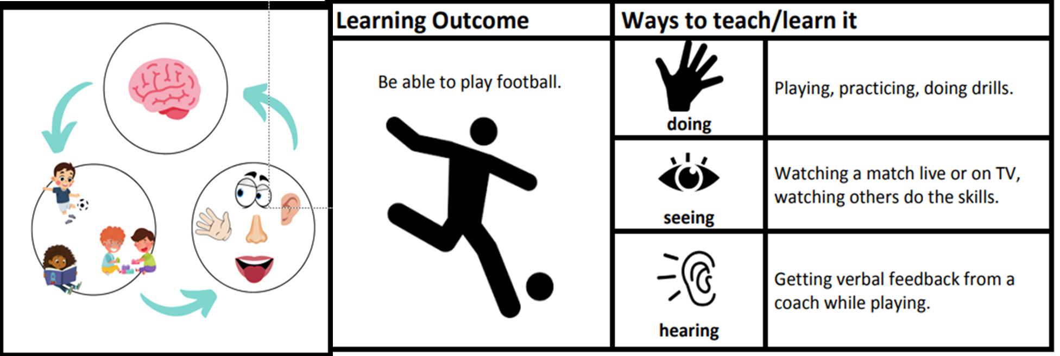


Learning theories are ideas about the ways students LEARN PROCESS and RETAIN information

Slide 13
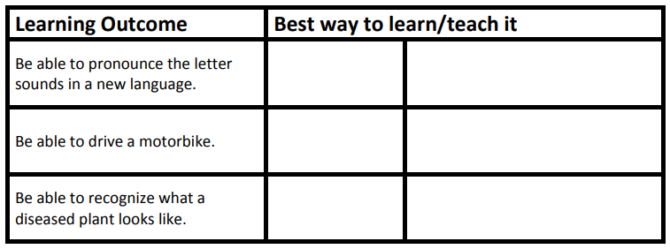
Read the learning outcome. Determine which is the best way to learn it.

Slide 14


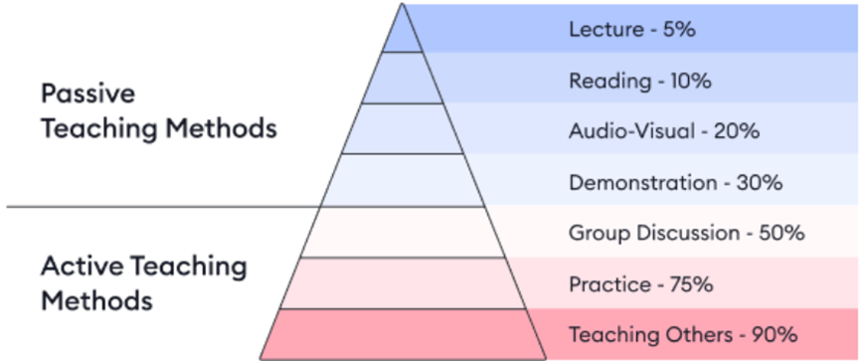



Learning theories are ideas about the ways students LEARN PROCESS and RETAIN information

Slide 15

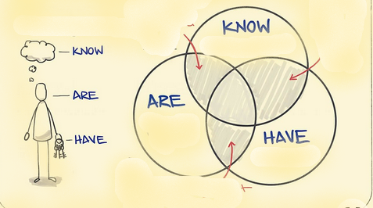




What to learn?
Knowledge
Attitudes
Competence
Skills

Slide 16



Domain of Learning
Knowledge
Skills
Attitude
Cognitive
Psychomotor
Affective

Slide 17
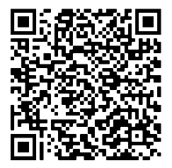
Page 13
Scan the below bar code to see verbs used for cognitive, psychomotor and affective domain.

Slide 18
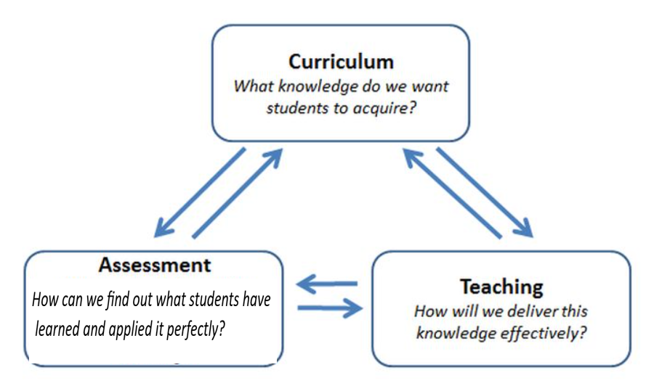









Theories of learning support curriculum design, learning activities, and assessment

Slide 19
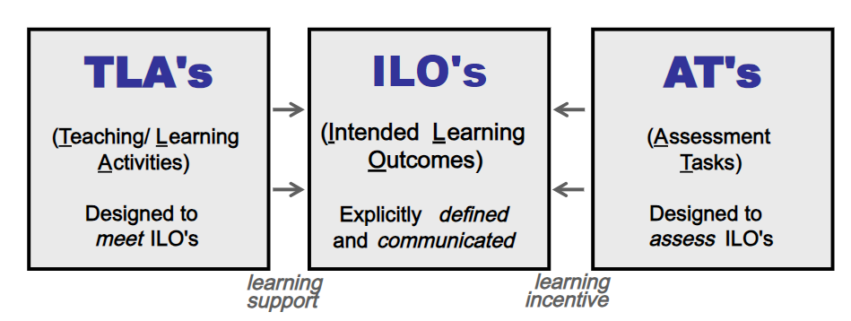











Interrelation among TLAs, ILOs, ATs)
How to teach it?
What to learn?
How to check learning?
Teaching support
learning incentive

Slide 20
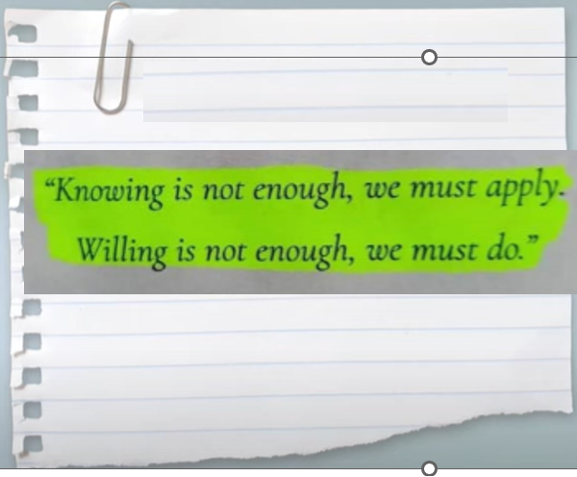
Competence
A competence is the ability to use appropriate combination of knowledge, skills, attitudes and values in order to accomplish a particular task successfully.
To be able to communicate fluently and accurately with others in everyday life situations rather than simply knowing grammatical rules and being able to produce lists of vocabulary.

Slide 21

Competence?

Slide 22


Slide 23
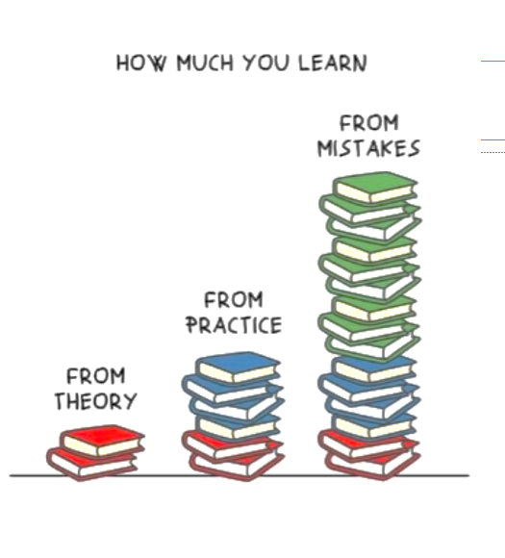
Sources of learning?

Slide 24
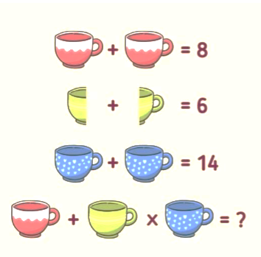
Calculate

Slide 25
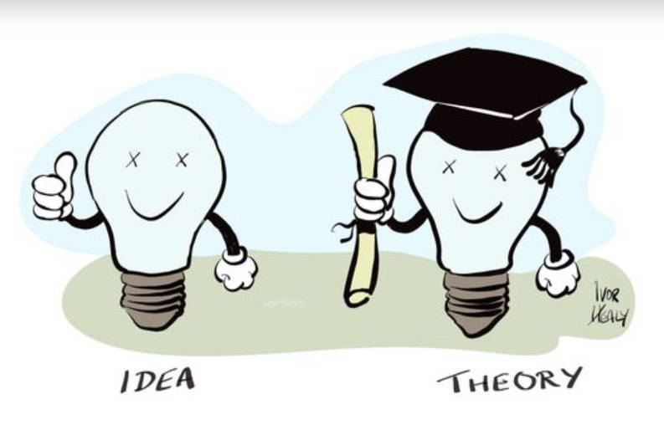







Theories of Learning
Mental is the primary object of learning(internal and external)
Stimulus-response association(external)
Knowledge can be constructed based on prior knowledge.
Learners can adjust their thinking based on new information(Adult learning)
learning by doing(experience)

Slide 26
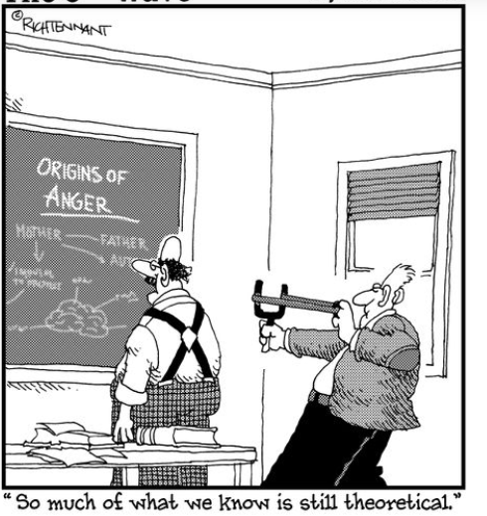

Slide 27
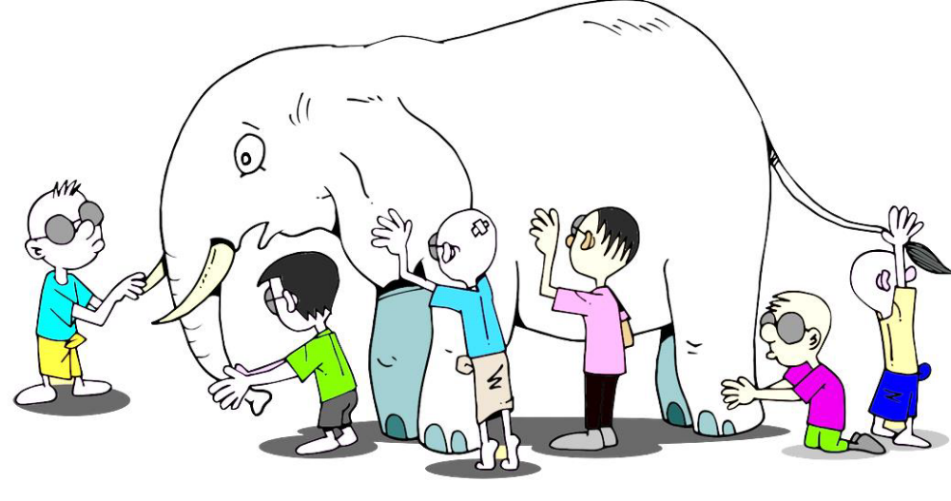

Slide 28
Application of Theories
Theories | Application
Cognitivism | Classifying information, Linking concepts, Real-world examples, discussion, problem-solving, providing picture.
Behaviorism | Establishment rules, verbal reinforcement, drilling/repetition, modelling
Constructivism | Case studies, Research projects, Problem-based learning, Brainstorming, Group work, Discovery learning
Experiential | Practical exercise, internship, etc.
Transformative | Inquiry and action research

Slide 29
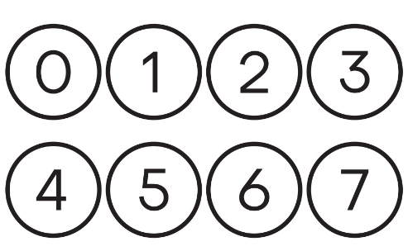

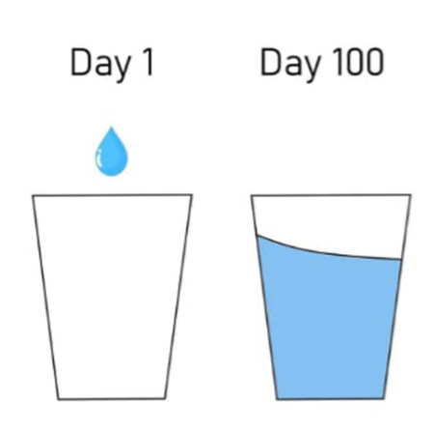
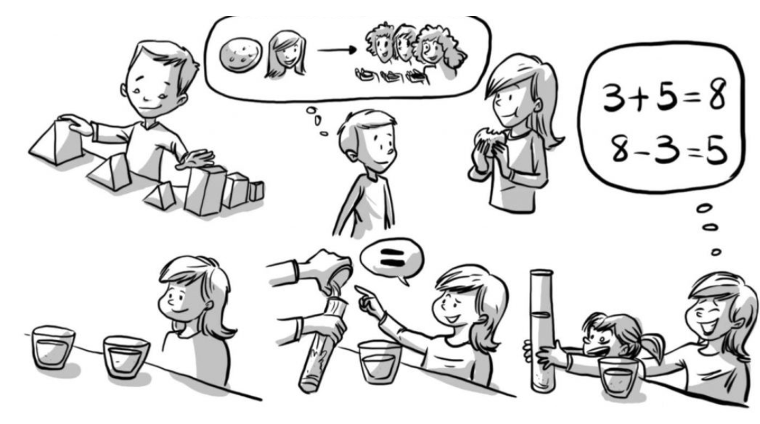
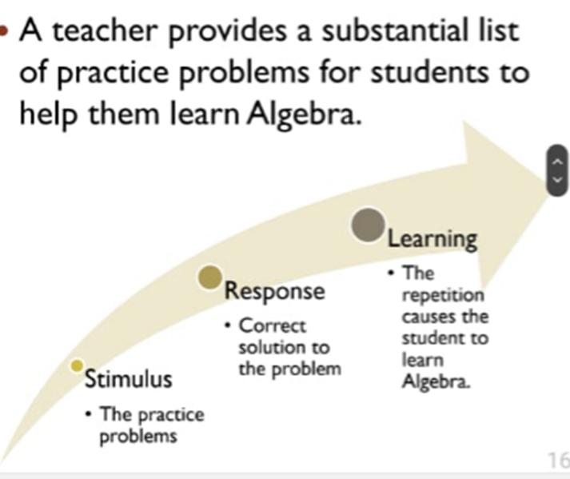


Slide 30
In nutshell,
There are significant differences among theories of learning, but all learning theories seek to understand and explain the learning process
Learning theories focus on understanding how students learn best, and how teaching impacts learning.

Slide 31


Slide 32
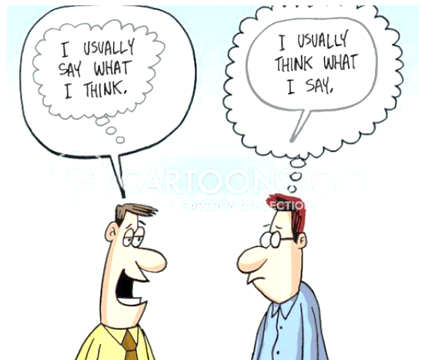
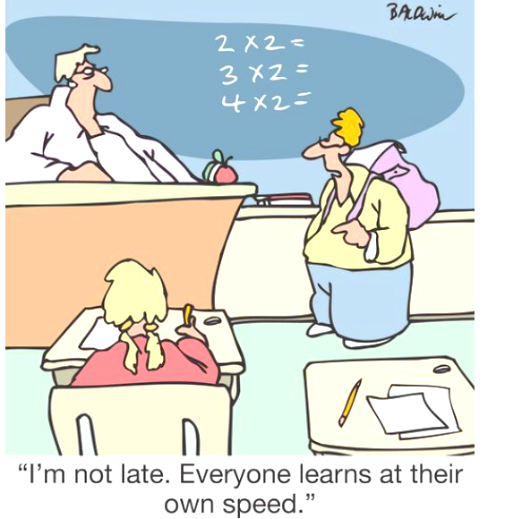
Learning Sytles

Slide 33
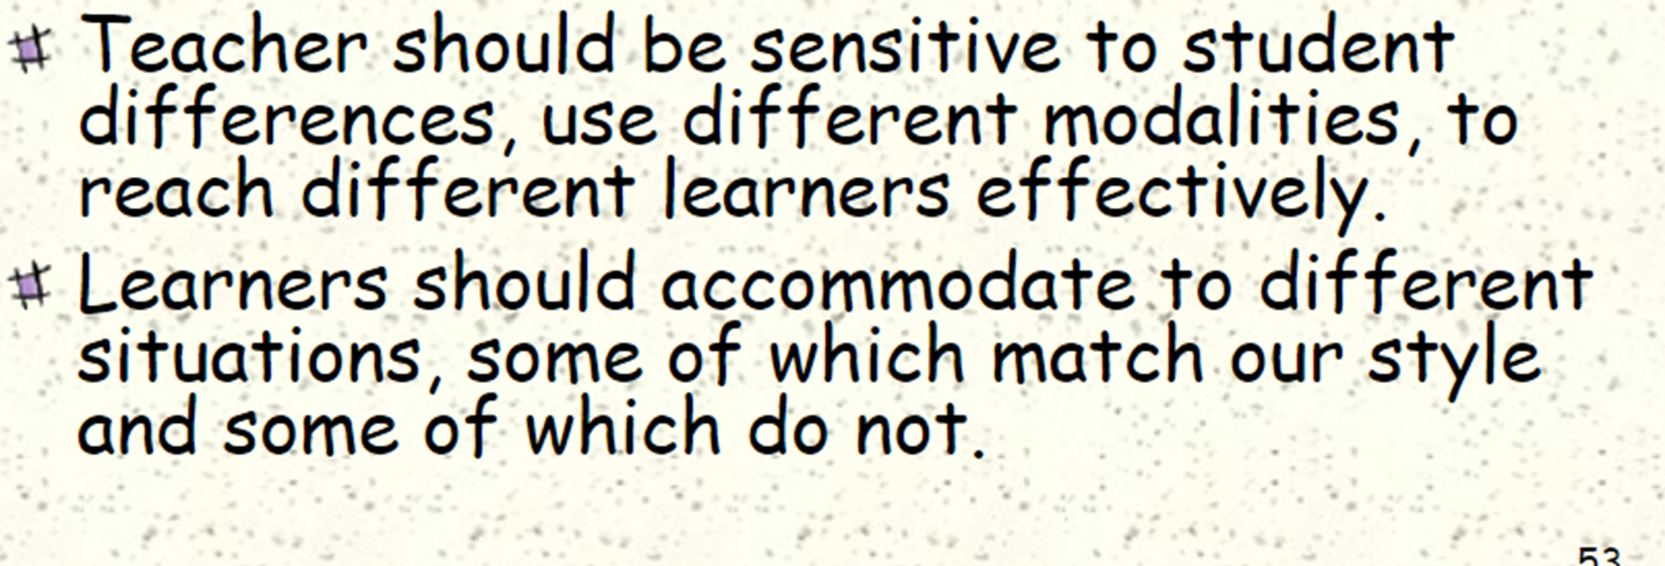
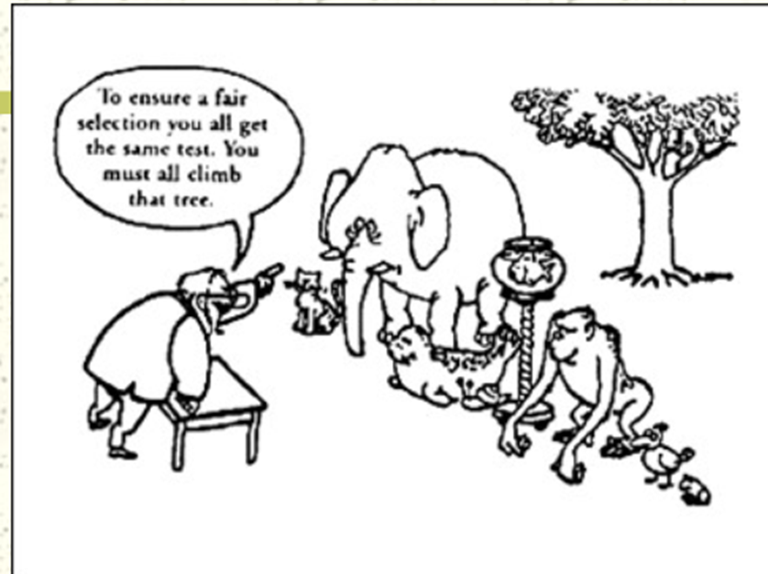
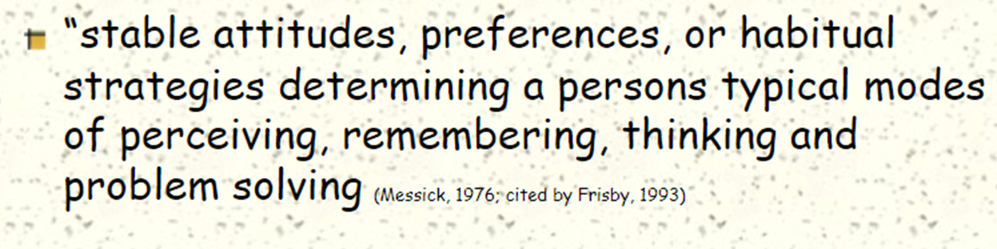
Learning Style

Slide 34
Agree Disagree
Each of us receives and processes information differently.
Teachers should make every attempt to know how students learn best.
Intelligence and ability are equal but differently distributed among individuals
Typical school assignments tend to discriminate in favor on against centra in learners.
Style-based instruction increases learning

Slide 35

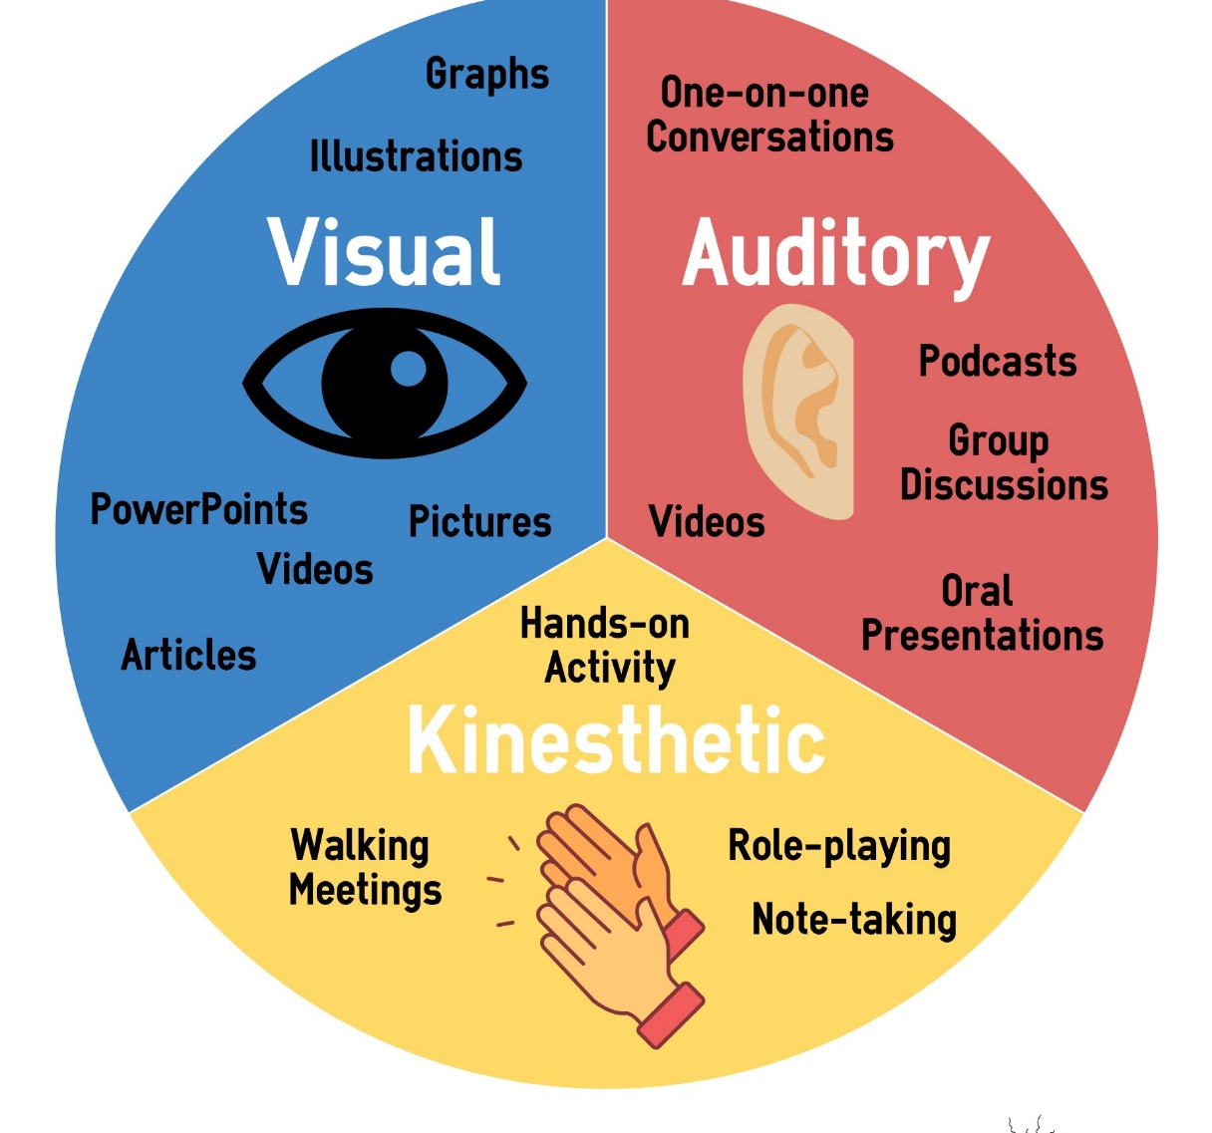


Understanding learning sytles

Slide 36

PAGE 18
To test your learning style, scan the below bar code, fill out the questionnaire, and click Ok to see the result.

Slide 37


Slide 38

Reflection
What did you enjoy today that you most valued? (name only three things)
How did this workshop help you rethink your role in academic teaching?
How can you apply what you have valued in your everyday duties?

Slide 39




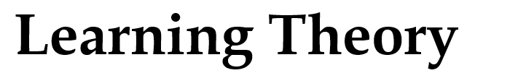

Page 15
Scan the below bar code to see more about student’s engagement

